Slide 1
Linear Regression

Slide 2
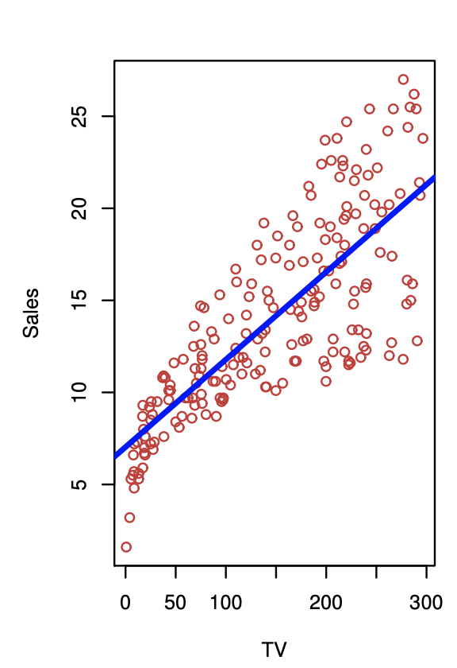
Assuming a true function that generated the data exists (but we can never observe it), we use the observed data to estimate the true function (i.e. learn the rules from the observations). The goal is to predict the output for new unseen inputs
For simplicity or by observing the data, we may decide that the function we want to estimate is linear (i.e. there is a linear relationship between inputs and outputs)

Slide 3
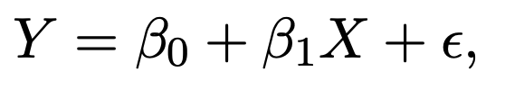
The Machine Learning Formula
Linear regression
Choose Family of Models
Estimate parameters
The line’s slope and intercept
Q3
Optional: minimize number of input variables, remove collinear variables, have training, test, validation sets etc.
Reduce complexity

Slide 4
Equation of a Line
Identify the line fit to the data by an intercept b₀ and a slope b₁
The equation of the line is y = b₀ + b₁x
^

Slide 5
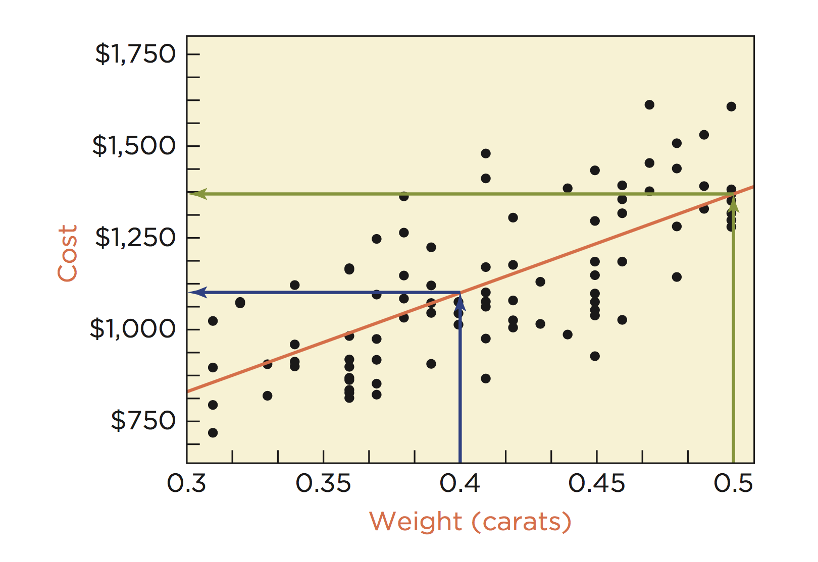
Notes:
linear association? r = 0.71

Slide 6
How do I choose the “best” b₀ and b₁?
There are many approaches to estimate the best b₀ and b₁ See here for a few.
Don’t worry! Python takes care of this part for us (thankfully).

Slide 7
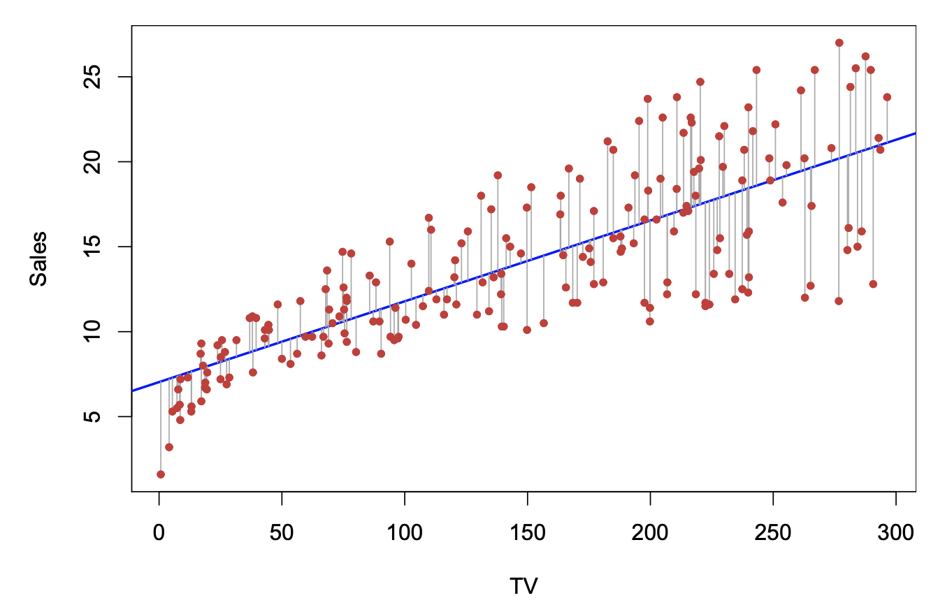
Least Squares
Residual Vertical deviation of a point from the line
The best fitting line collectively makes the squares of the residuals as small as possible
The choices of b₀ and b₁ minimize the sum of the squared residuals
Go to slide 5 to see the mathematical formulation of estimating the line’s parameters using Least Squares

Slide 8
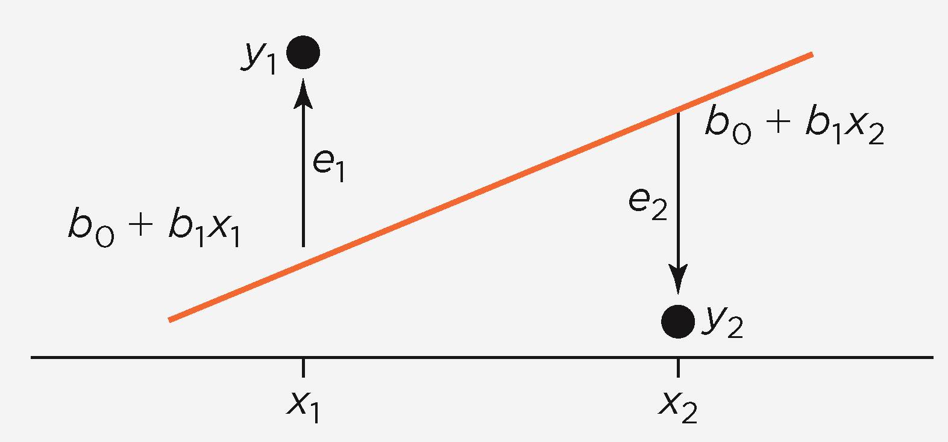

Slide 9
Interpretation
Intercept Average response when x = 0 and where the line crosses the y axis
Slope Estimates the marginal cost used to find the variable cost

Slide 10
Residuals
Show variation that remains in the data after accounting for the linear relationship defined by the fitted line
If the least squares line captures the association between x and y, then a plot of residuals versus x should have no pattern

Slide 11
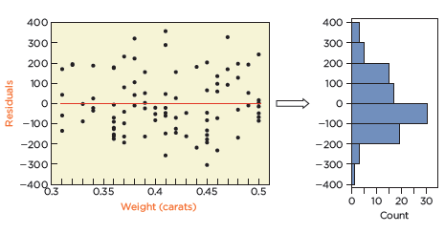
Standard Deviation of Residuals
Measures how much the residuals vary around the fitted line
95% of prices within 290 of regression

Slide 12
R-Squared (r²)
Square of the correlation between x and y
Fraction of the variation accounted for by the least squares regression line
r2 = 0.5 line explains 50% of the variation in price

Slide 13
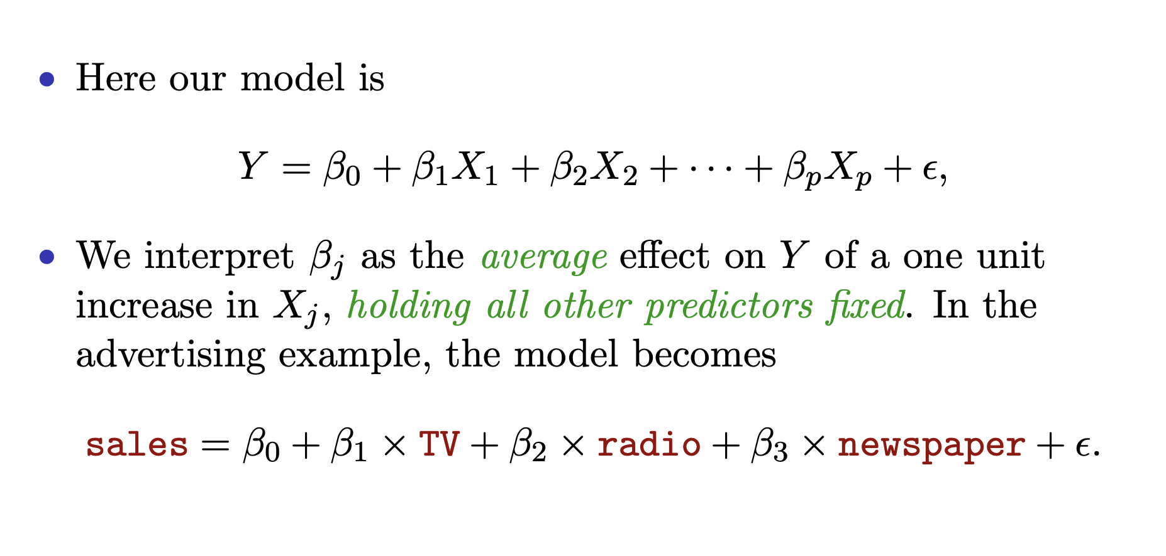
Interpreting coefficients
Source

Slide 14
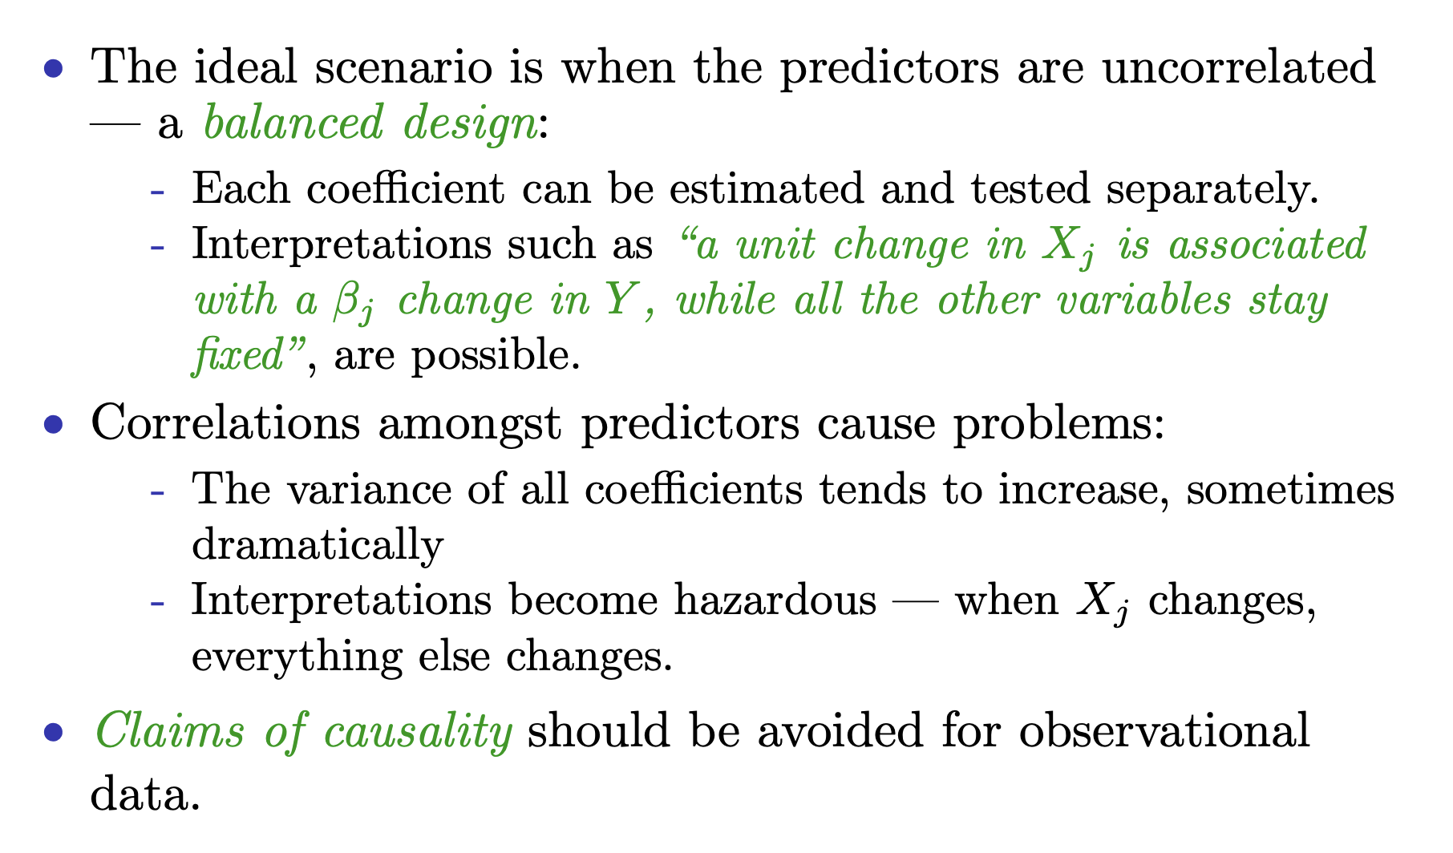
Interpreting coefficients
Source

Slide 15
Outliers?

Slide 16
Regression Checklist
No obvious lurking variables:
Are there other explanatory variables?
Linear:
Use scatterplots
Random residual variation:
Use residual plots to make sure there is no pattern
Interpreting coefficients:
Avoid causal statements!

Slide 17
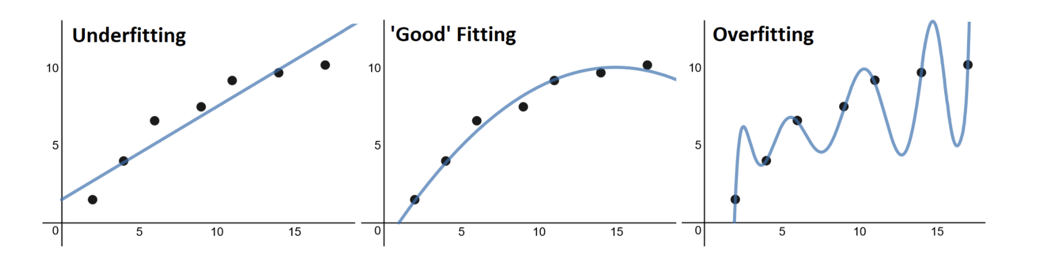
Flexibility vs. interpretability

Slide 18
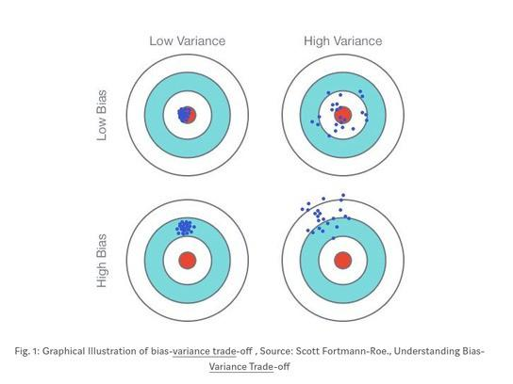
How to think about any ML algorithm performance
Model performance can be thought of in two areas:
Bias: the difference between actual and predicted values. Generally associated with incorrect assumptions about the data. The more rigid the model the higher the bias
Variance: the errors we make on a new unseen dataset. The more flexible the model the higher the variance
Ideally we want low bias and low variance but each model will have different degrees of trade-off. In general as a model’s flexibility (complexity) increases, its variance increases and its bias decreases
Source

